Slide 1
Time Series Regression

Slide 2
Regression Models
Leading indicator: an explanatory variable that anticipates coming changes in a time series.
Leading indicators are hard to find.
Predictor: an ad hoc explanatory variable in a regression model used to forecast a time series (e.g., time index, t)

Slide 3
Regression Models
Polynomial Trends
Polynomial trend: a regression model for a time series that uses powers of t as explanatory variables.
Example: the third-degree or cubic polynomial.

Slide 4
Regression Models
Polynomial Trends
Avoid forecasting with polynomials that have high powers of the time index.

Slide 5
PREDICTING SALES OF NEW CARS USING REGRESSION METHODS
Motivation
The U.S. auto industry neared collapse in 2008 - 2009.
How badly did the recession hit this industry?
What would we have expected had the recession
not happened?

Slide 6
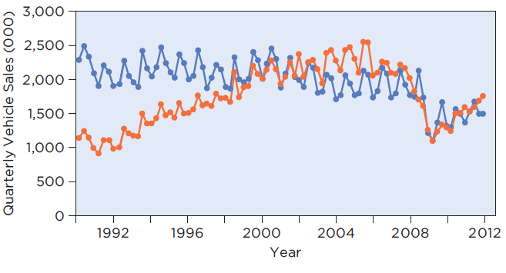
PREDICTING SALES OF NEW CARS USING REGRESSION METHODS
Step 1: Timeplot of quarterly sales (in thousands)
Cars in blue; light trucks in orange.

Slide 7
PREDICTING SALES OF NEW CARS USING REGRESSION METHODS
Method
Use regression to model the trend and seasonal components apparent in the timeplot.
Use a polynomial for trend and three dummy variables for the four quarters.
Let Q1 = 1 if quarter 1, 0 otherwise;
Q2 = 1 if quarter 2, 0 otherwise;
Q3 = 1 if quarter 3, 0 otherwise.
The fourth quarter is the baseline category.
In practice you may consider the possibility of lurking variables (e.g., gasoline prices).

Slide 8
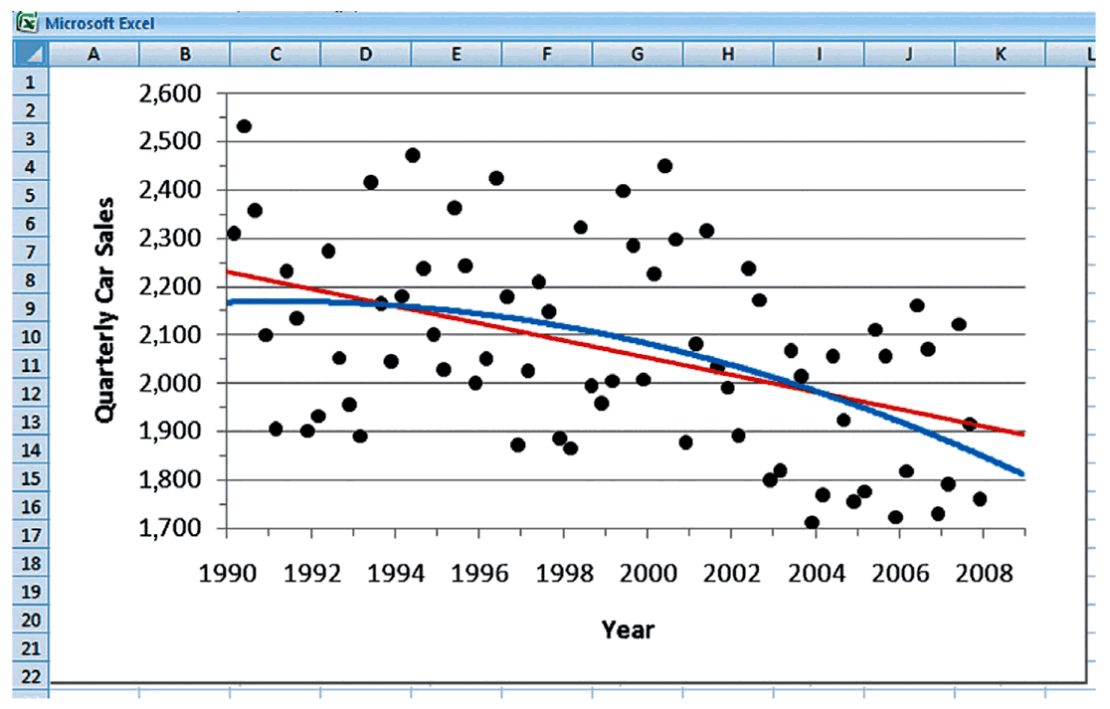
PREDICTING SALES OF NEW CARS USING REGRESSION METHODS
Mechanics
Linear and quadratic trend fit to the data.
Linear appears more appropriate.

Slide 9
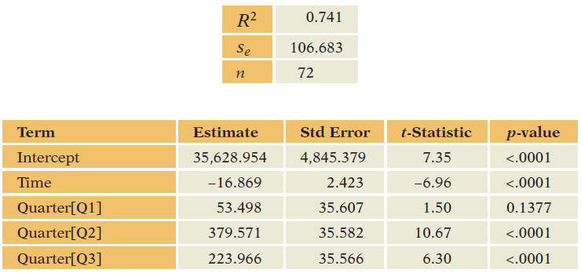
PREDICTING SALES OF NEW CARS USING REGRESSION METHODS
Mechanics
Estimate the model.
Check conditions before proceeding with
inference.

Slide 10
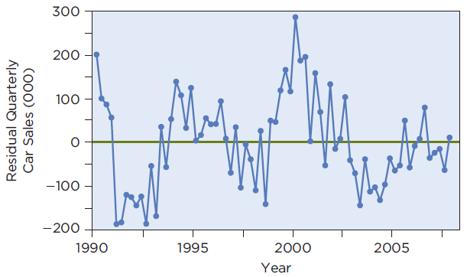
PREDICTING SALES OF NEW CARS USING REGRESSION METHODS
Mechanics
Examine residual plot.
This plot, along with the Durbin-Watson statistic
D = 0.86, indicates dependence in the residuals.
Cannot form confidence or prediction intervals.

Slide 11
PREDICTING SALES OF NEW CARS USING REGRESSION METHODS
Message
A regression model with linear time trend and seasonal factors closely predicts sales of new cars in the first two quarters of 2008, but substantially over predicts sales in the last two quarters and into 2009.
The forecasts for 2008 are 1,807 thousand for the first quarter, 2,129 thousand for the second quarter, 1,969 thousand for the third quarter, and 1,741 thousand for the fourth quarter.

Slide 12
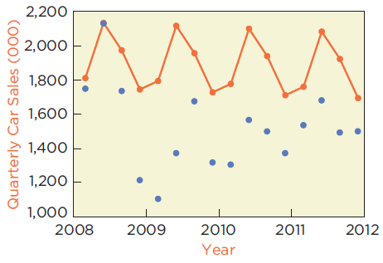
PREDICTING SALES OF NEW CARS USING REGRESSION METHODS
Message
Actual values in blue, historical forecasts in orange.
Even though the recession ended June 2009, car sales remain less than historical trend.

Slide 13
Regression Models
Autoregression
Autoregression: a regression that uses prior values of the response as predictors.
Lagged variable: a prior value of the response in a time series.

Slide 14
Modeling Cyclical Component using Regression Models
Autoregression: predicting data using its own past
Simplest is a simple regression that has one lag:
This model is called a first-order autoregression, denoted as AR(1).

Slide 15
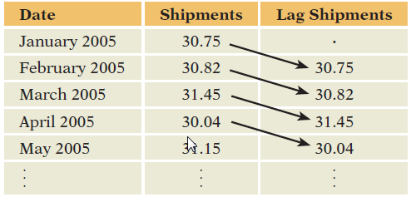
AutoRegression: Example
Autoregression
Example: AR(1) for Monthly Shipments

Slide 16
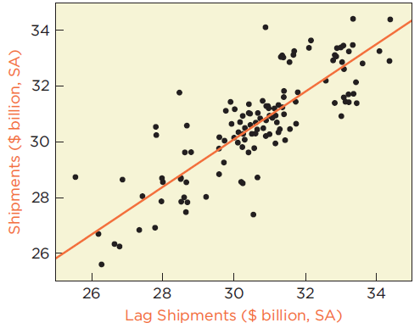
Regression Models: Example
Autoregression
Scatterplot of Shipments on the Lag
Indicates a strong positive linear association.

Slide 17
Regression Models: Example
Forecasting an Autoregression
Example: Use AR(1) to forecast shipments.
For Jan. 2010, use observed shipment for Dec.
2009:

Slide 18
Regression Models
Forecasting an Autoregression
For Feb. 2010, there is no observed shipment for Jan. 2010. Use forecast for Jan. 2010:
Once forecasts are used in place of observations, the uncertainty compounds and is hard to quantify.

Slide 19
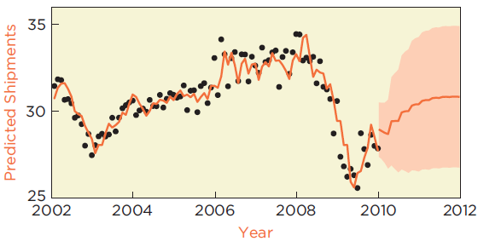
Regression Models: Example
AR(5) Model for Shipments
Fit, forecasts and prediction intervals.

Slide 20
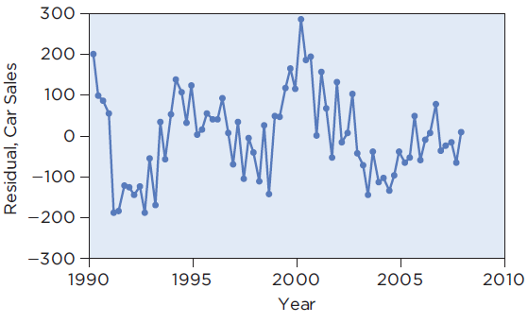
Checking the Model
Autoregression and the Durbin-Watson Statistic
New Car Sales

Slide 21
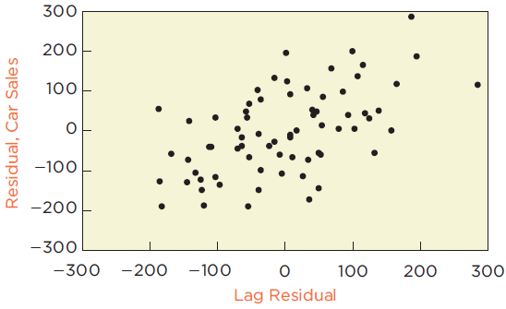
Checking the Model
Autoregression and the Durbin-Watson Statistic
Example 27.1: New Car Sales

Slide 22
Checking the Model
Autoregression and the Durbin-Watson Statistic
Residual plots show that the regression model leaves substantial dependence in the residuals.
In the scatterplot the correlation between residuals e_{t} and e_{t-1} is apparent (r = 0.56).

Slide 23
Checking the Model
Autoregression and the Durbin-Watson Statistic
The Durbin-Watson statistic is related to the autocorrelation of the residuals in a regression:

Slide 24
Checking the Model
Summary
Examine these plots of residuals when fitting
a time series regression:
Timeplot of residuals;
Scatterplot of residuals versus fitted values; and
Scatterplot of residuals versus lags of the residuals.

Slide 25
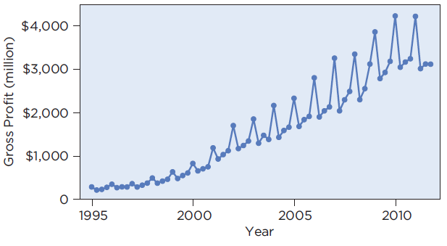
FORECASTING BEST BUY PROFITS
Motivation
Forecast Best Buy’s gross profits for 2012. Use
their quarterly gross profits from 1995 to 2011.

Slide 26
FORECASTING BEST BUY PROFITS
Method
Best Buy’s profits have not only grown nonlinearly (faster and faster), but the growth is seasonal.
In addition, the variation in profits appears to be increasing with level.
Consequently, transform the data by calculating the percentage change from year to year. Let y_{i} denote these year-over-year percentage changes.

Slide 27
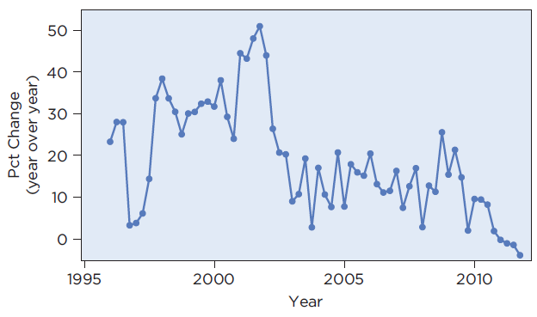
FORECASTING BEST BUY PROFITS
Method
Timeplot of year-over-year percentage change.

Slide 28
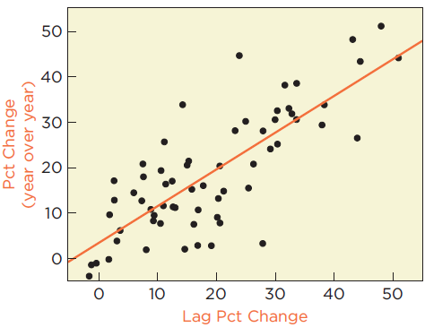
FORECASTING BEST BUY PROFITS
Method
Scatterplot of the year-over-year percentage
change on its lag.
Indicates positive linear association.

Slide 29
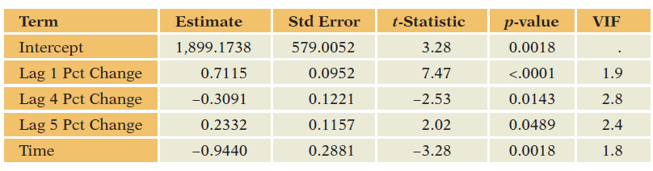
FORECASTING BEST BUY PROFITS
Mechanics
Estimate the model.

Slide 30
FORECASTING BEST BUY PROFITS
Mechanics
All conditions for the model are satisfied; proceed
with inference.
The fitted equation has R² = 74.5% with s_{e} = 6.99.
The F-statistic shows that the model is statistically
significant. Individual t-statistics show that each
slope is statistically significant.

Slide 31
FORECASTING BEST BUY PROFITS
Mechanics
Forecast for the first quarter of 2012:
However, with s_{e} = 6.99, the range of the 95%
prediction interval includes zero. It is
[-17.5% to 12.1%].

Slide 32
FORECASTING BEST BUY PROFITS
Message
The time series regression that describes year-over-year percentage changes in gross profits at Best Buy is significant and explains 75% of the historical variation.
It predicts profits in the first quarter of 2012 to fall about 2.4% below profits in the first quarter of 2011; however, the model can’t rule out an increase (up to 12%) or substantial contraction (dropping about 17%).

Slide 33
Best Practices
Provide a prediction interval for your forecast.
Find a leading indicator.
Use lags in plots so that you can see the autocorrelation.

Slide 34
Best Practices (Continued)
Provide a reasonable planning horizon.
Enjoy finding dependence in the residuals of a model.
Check plots of residuals.

Slide 35
Pitfalls
Don’t summarize a time series with a histogram unless you’re confident that the data don’t have a pattern.
Avoid polynomials with high powers.
Do not let the high R² of a time series regression convince you that predictions from the regression will be accurate.

Slide 36
Pitfalls (Continued)
Do not include explanatory variables that also have to be forecast.
Don’t assume that more data is better.

